Slide 1
Pediatric Bone Age Assessment using Deep Neural Networks
Carly Mester and Hans Larson

Slide 2
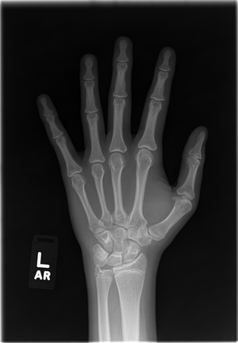
Purpose
During a child’s development, the bones of a skeleton change in size and shape
Bone age is often requested by pediatricians for comparison with chronological age for diagnosing diseases which result in tall or short stature in children, among other abnormalities

Slide 3
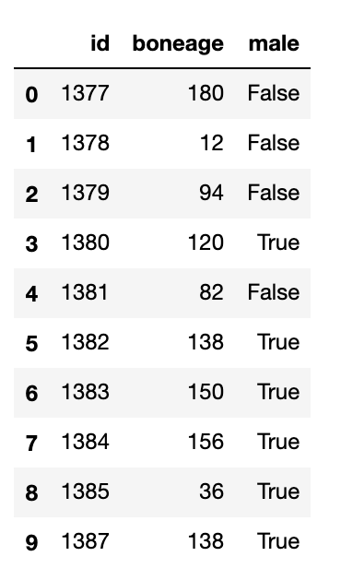
About The Data
To increase the implementation of AI in radiology, the Radiological Society of North America created a contest in 2017 to try and correctly identify the age of a child based on an X-ray of their left hand
A CSV provides 12,611 observations with an ID number, actual bone age (in months for greater accuracy), and sex, while a separate folder contains the corresponding 12,611 X-ray images

Slide 4
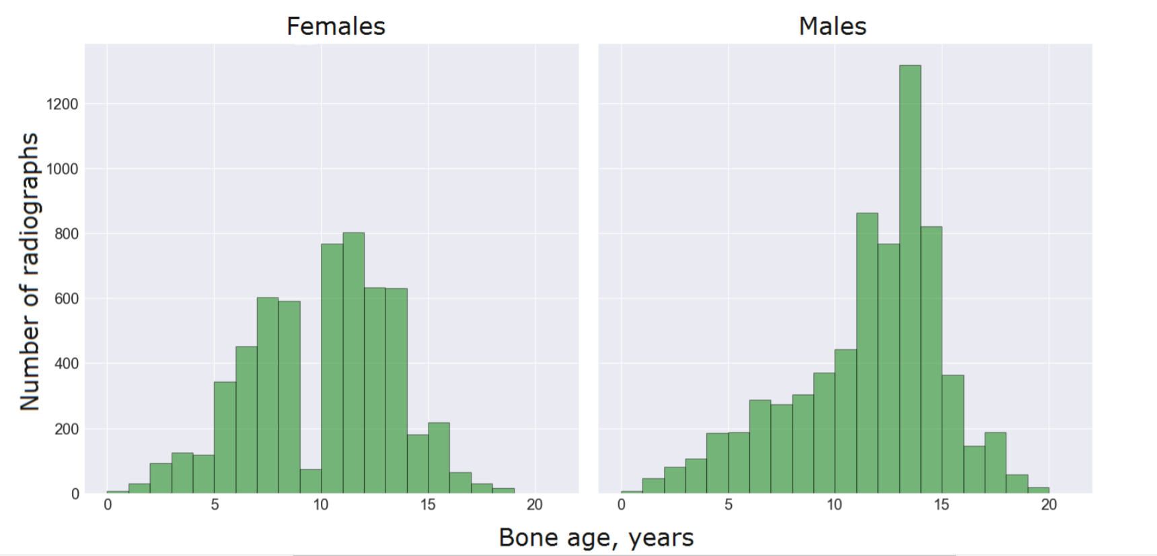

Slide 5
Our Goals
Uses of bone age assessment:
Estimate the maturity of a child’s skeletal system
Look at the actual age of the child combined with our own predictions
Determine if there are any signs of growth problems
We are working through a previously-made kernel on Kaggle to try to replicate his findings and use them as inspiration for our own ideas

Slide 6
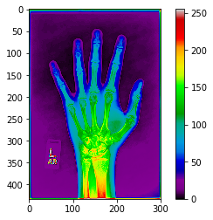
Preliminary Experiment: Pixel Intensity/Attention Maps
Pixel intensity equates to the brightness of a particular pixel
Stored as one-byte unsigned characters 0-255
0=black 255=white
The location of soft tissue could be an indicator of someone’s relative age
We are trying to see if pixel intensity at soft tissue locations correlate with the results of the attention maps

Slide 7
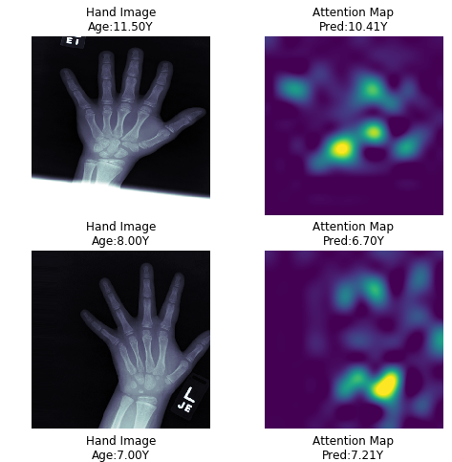
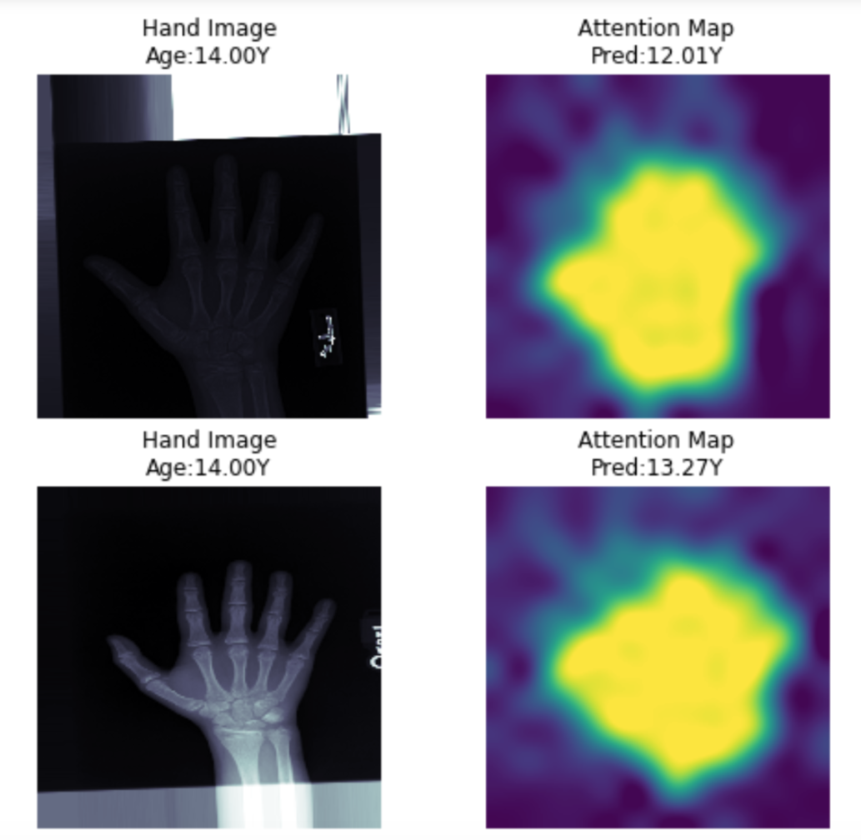
Attention Map
← Guidance kernel
Attention maps pinpoint the most important parts of the image to look at
With very complex code
We are working to refine our model to match the accuracy of the guidance kernel (pictured here)
Is the attention model better than the pixel intensity model?
Our model →

Slide 8
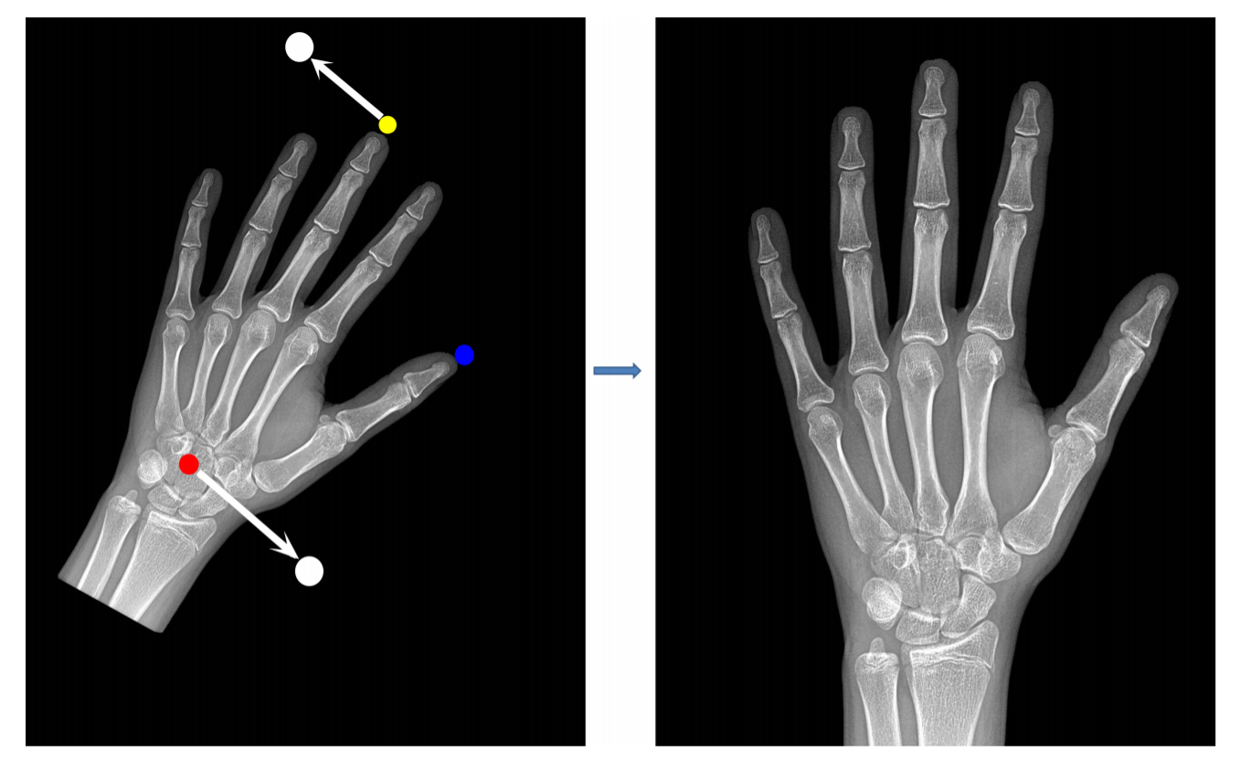
Next Steps
Scaling images
Downscale images to reduce computational costs
Input augmentations: rotation, translation, and zoom
Pixel intensity
Compare to attention maps to see if there is correlation between the two/if the same areas are highlighted

